Slide 1
Building an Internal Application Using the SAS Stored Process Web Application
Mara Werner
BASUG Quarterly Meeting
June 2019

Slide 2
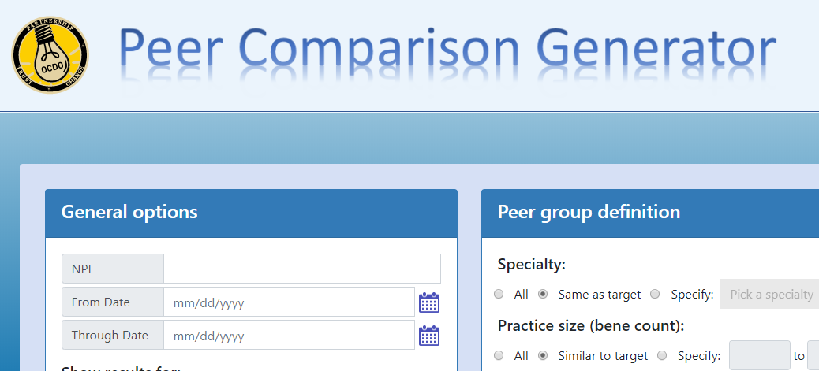
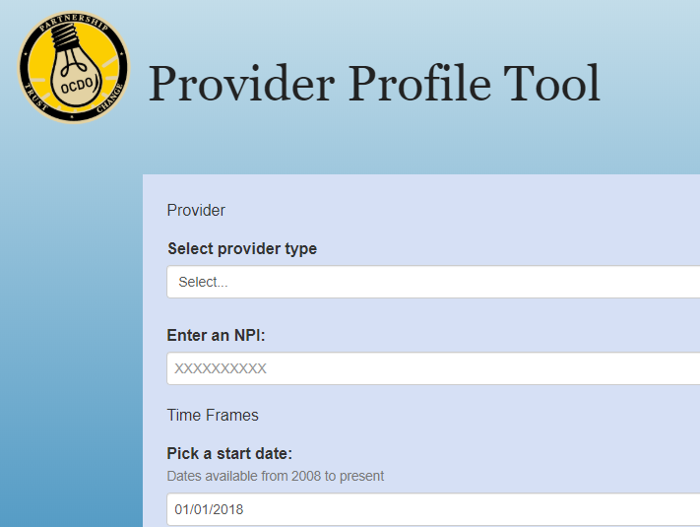
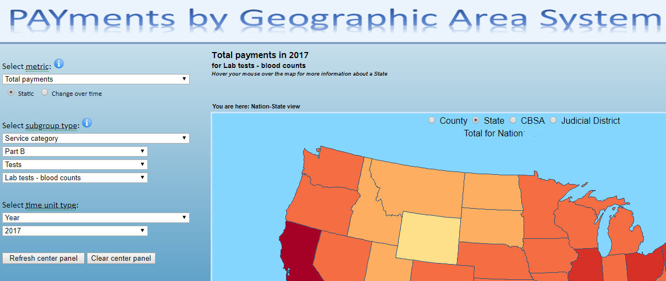
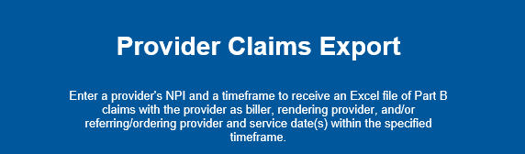

Slide 3
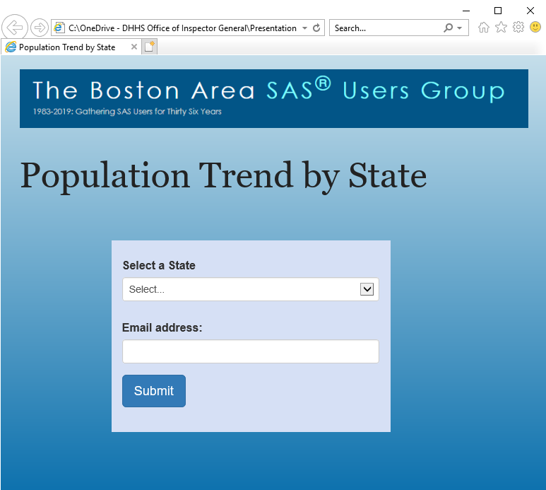
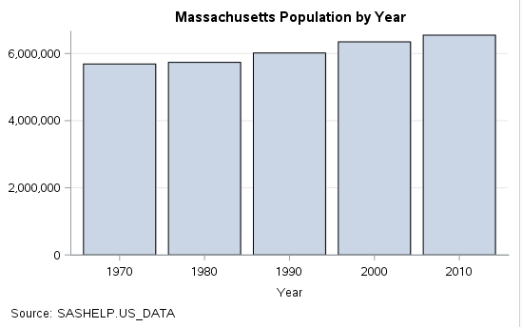
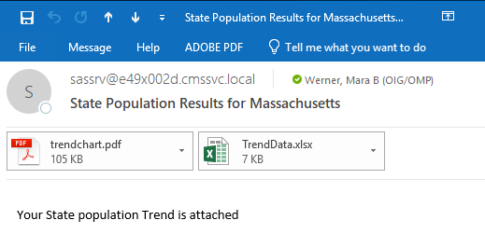
How it Works
Customer uses web form
Calls Stored Process
Parameterized SAS Code
Gets the data
Generates PDF and Excel output
Email results to customer

Slide 4
Dependencies
SAS Display Manager
SAS Enterprise Guide (EG)
SAS Stored Process Server
SAS Metadata Server
SMTP Mail Server
(…this list may be incomplete)

Slide 5
Example: Trend in State Population

Slide 6
SAS Code
proc sql;
create table state_pop_AL as
select statename
, population_1970
, population_1980
, population_1990
, population_2000
, population_2010
from sashelp.us_data
where Statename = 'Alabama'
;quit;

Slide 7
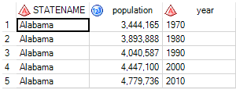
SAS Code
proc transpose data=state_pop_AL out=state_pop_AL_transpose;
by statename ;
run;
data state_pop_AL_transpose2;
set state_pop_AL_transpose (rename=(col1=population));
year=substr(_label_,1,4);
drop _name_ _label_;
run;

Slide 8
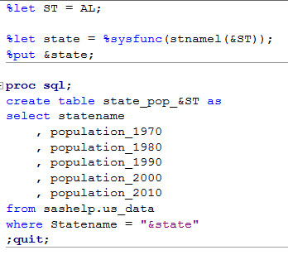
Substituting Macros for Text
Create the macro variable “ST” and define it (for this example) with the Alabama state code
Define a second macro variable with the written State name – using the SAS stnamel() function
Substitute ‘AL’ with ‘&ST’ throughout the code
Two notes:
1. Macros in double quotes will resolve, but not single quotes
2. Put a period after the macro call if it’s in the middle of a string

Slide 9
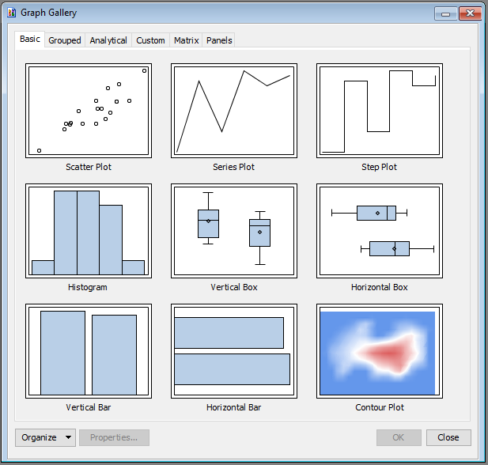
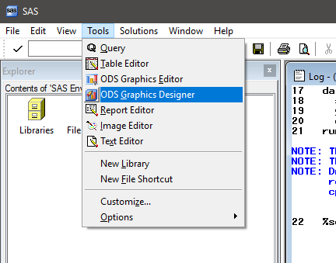
ODS Graphics Designer

Slide 10
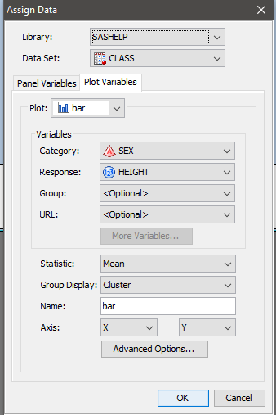
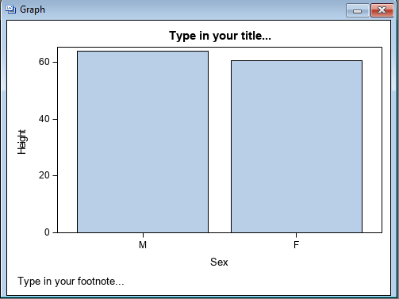
ODS Graphics Designer

Slide 11
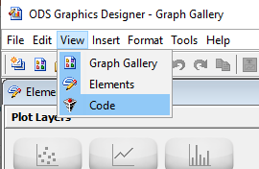
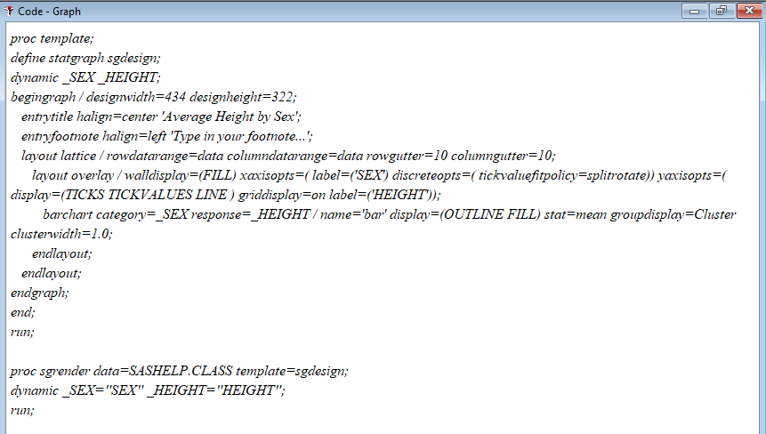
ODS Graphics Designer

Slide 12
Modify the Template for Example Data
/*Define the template*/
proc template;
define statgraph ST_pop_graph;
dynamic _YEAR _POPULATION;
begingraph / designwidth=550 designheight=350;
entrytitle halign=center "&state Population by Year";
entryfootnote halign=left 'Source: SASHELP.US_DATA';
layout lattice / rowdatarange=data columndatarange=data rowgutter=10 columngutter=10;
layout overlay / walldisplay=(FILL)
xaxisopts=( label=('Year') discreteopts=( tickvaluefitpolicy=splitrotate))
yaxisopts=( display=(TICKS TICKVALUES LINE ) griddisplay=on label=('Population'));
barchart category=_YEAR response=_POPULATION /
name='bar' display=(OUTLINE FILL) stat=mean groupdisplay=Cluster clusterwidth=1.0;
endlayout;
endlayout;
endgraph;
end;
run;
/*Render graph*/
proc sgrender data=state_pop_&ST._transpose2 template=ST_pop_graph;
dynamic _YEAR="Year" _POPULATION="Population";
run;

Slide 13
What’s in the template
proc template;
define statgraph ST_pop_graph;
dynamic _YEAR _POPULATION;
begingraph / designwidth=550 designheight=350;
entrytitle halign=center "&state Population by Year";
entryfootnote halign=left 'Source: SASHELP.US_DATA';
layout lattice / rowdatarange=data columndatarange=data rowgutter=10 columngutter=10;
layout overlay / walldisplay=(FILL)
xaxisopts=( label=('Year') discreteopts=( tickvaluefitpolicy=splitrotate))
yaxisopts=( display=(TICKS TICKVALUES LINE ) griddisplay=on label=('Population'));
barchart category=_YEAR response=_POPULATION /
name='bar' display=(OUTLINE FILL) stat=mean groupdisplay=Cluster clusterwidth=1.0;

Slide 14
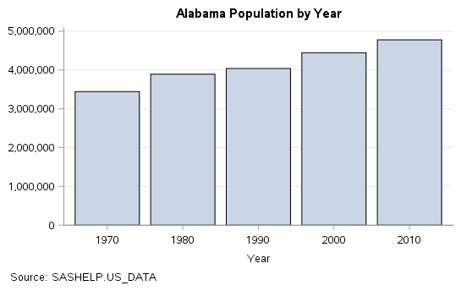
/*Render graph*/
proc sgrender data=state_pop_&ST._transpose2 template=ST_pop_graph;
dynamic _YEAR="Year" _POPULATION="Population";
run;

Slide 15
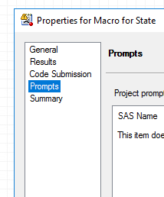
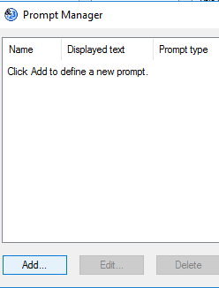
Adding SAS Prompts from EG
1
2
3

Slide 16
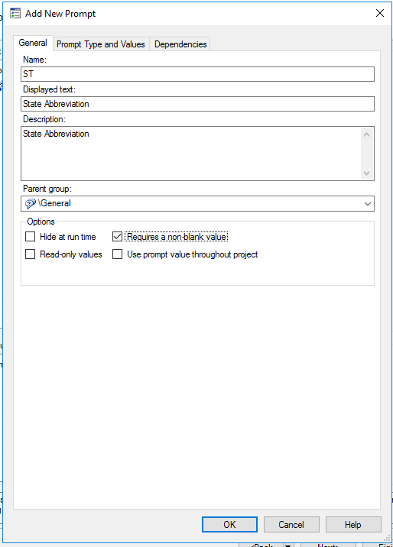
SAS Prompts

Slide 17
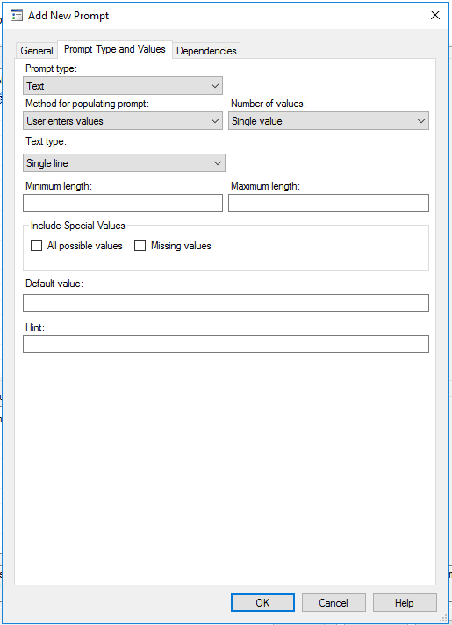

Slide 18
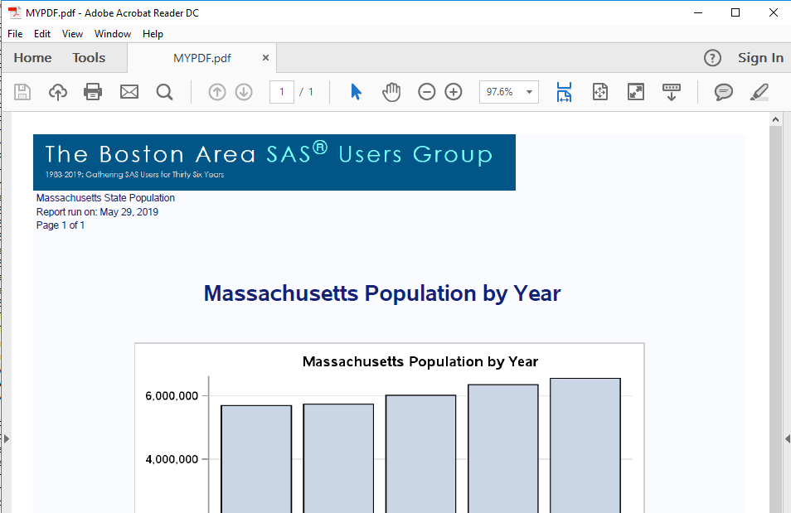
Output to PDF

Slide 19
Create a Temporary File Path
/*start a pdf document for the results*/
filename mypdf temp;
/*Get the path for the PDF file */
data _null_;
length pdffile $1000;
pdffile=pathname('mypdf');
call symputx("PDFFILE",pdffile);
run;
%put &PDFFILE;

Slide 20
ODS PDF
/*start a pdf document for the results*/
ods pdf (id=emailpdf)
style=htmlblue
file=mypdf
bookmarklist=none;
options nodate nonumber;
ods escapechar='^';
… body code here…
/*close pdf destination to finish document*/
ods pdf(emailpdf) close;

Slide 21
ODS Text
/* Add a document header/banner */
ODS text= "^S={preimage='/sasdata/users/w0es/BASUG logo.png
?height=94px&width=811px'}";
ods text = "^S={font_size=8PT Just=L} &State State Population";
ods text = "^S={font_size=8PT Just=L} Report run on: &today";
ods text = "^S={font_size=8PT Just=L} Page ^{thispage} of ^{lastpage}";
/* Write a Title */
ods text= "^S={font_size=18pt just=C font_weight=bold}^2n&State Population by Year^2n";
/*Render graph*/
proc sgrender data=state_pop_&ST._transpose2 template=ST_pop_graph;
dynamic _YEAR="Year" _POPULATION="Population";
run;

Slide 22
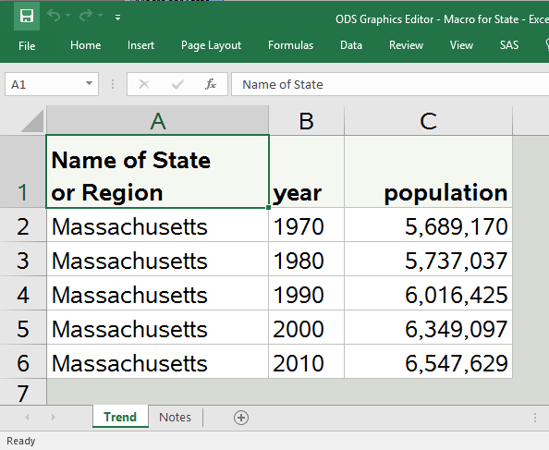
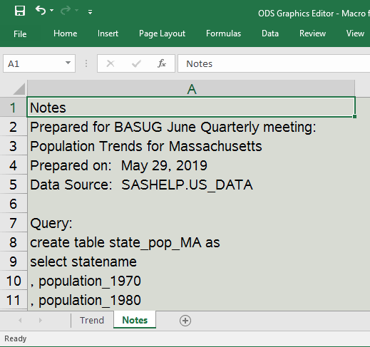
Output to Excel

Slide 23
Create a Temporary File Path
/*Create Excel File with Data*/
filename myexcel temp;
/*create a temporary file path for the excel file*/
data _null_;
length excelfile $1000;
excelfile=pathname('myexcel');
call symputx("EXCELFILE",excelfile);
run;
%put &excelfile;

Slide 24
ODS Excel
/*send the data to excel in a way that keeps the formatting*/
title; footnote;
ods listing close;
ods excel file="&EXCELFILE..xlsx" style=statistical
options(sheet_name="Trend");
proc print data=state_pop_&ST._transpose2 noobs label split='*';
run; quit;
ods excel close;
ods listing;

Slide 25
Create a Notes Tab
data Notes (keep=notes);
infile cards delimiter='*';
input notesprep :$100.;
Notes=dequote(resolve(quote(Notesprep)));
cards;
Prepared for BASUG June Quarterly meeting: Population Trends for &State
Prepared on: &today *
Data Source: SASHELP.US_DATA *
*
Query: *
create table state_pop_&ST as*
select statename, population_1970, population_1980*
, population_1990, population_2000, population_2010*
from sashelp.us_data*
where Statename = "&state"*
; run;

Slide 26
Add Notes to Excel
proc export data= notes
outfile="&EXCELFILE"
dbms=xlsx
replace;
sheet = 'Notes'
;quit;

Slide 27
Send Results by Email
/* Generate email*/
filename em email
to="&emailaddress"
attach=("&PDFFILE" name="trendchart"
content_type="application/pdf" ext="pdf")
attach=("&EXCELFILE..xlsx" name="TrendData"
content_type="application/excel" ext="xlsx")
subject="State Population Results for &State";
data _null_;
file em;
put 'Your State population Trend is attached';
put /;
put 'Please do not respond to this email.';
put /;
run;

Slide 28
Email With Results

Slide 29
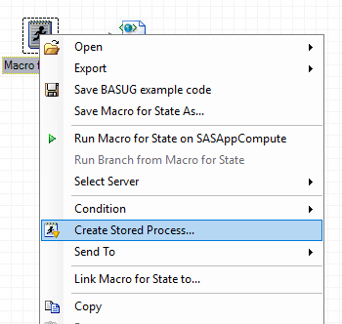
Stored Process from Code in SAS EG

Slide 30
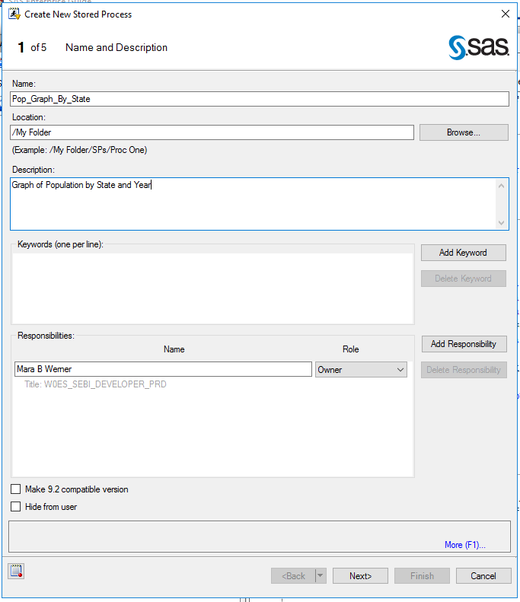

Slide 31
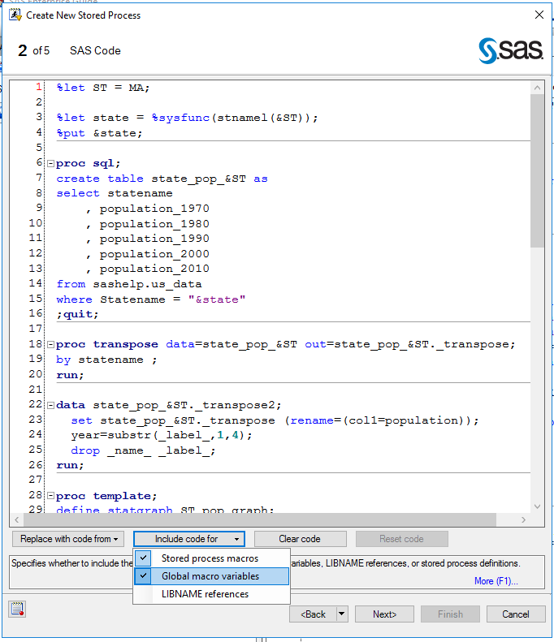

Slide 32
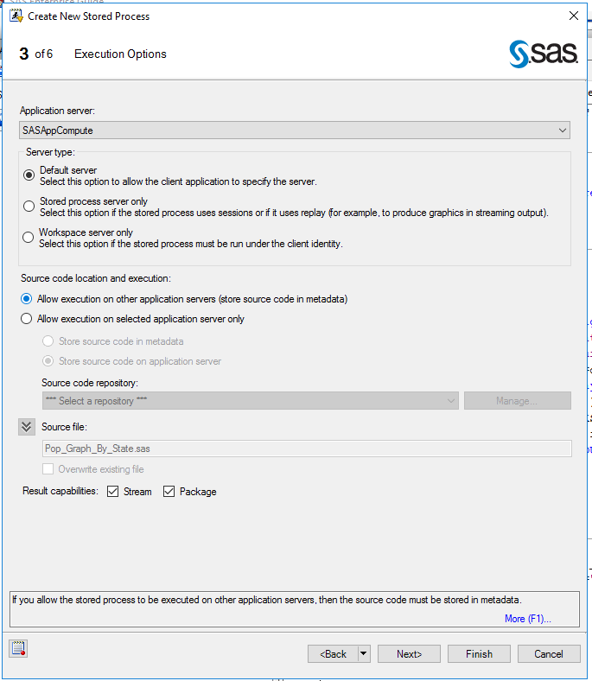

Slide 34
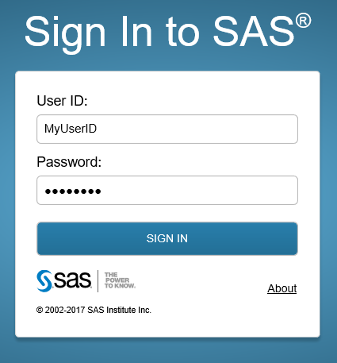
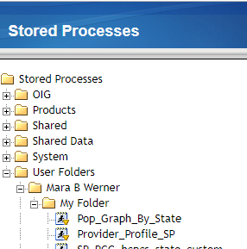
SAS Stored Process Web App

Slide 35
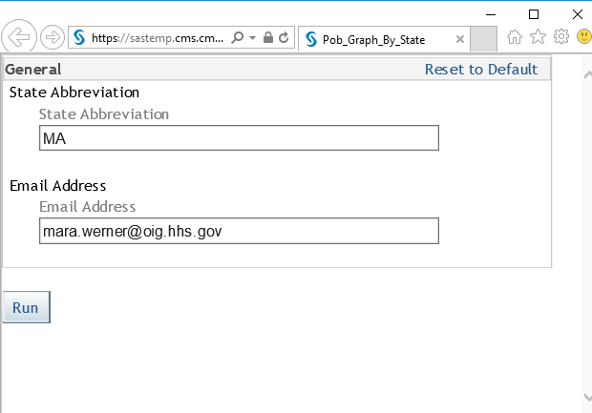
SAS Stored Process Web App

Slide 36
Custom Front End

Slide 37
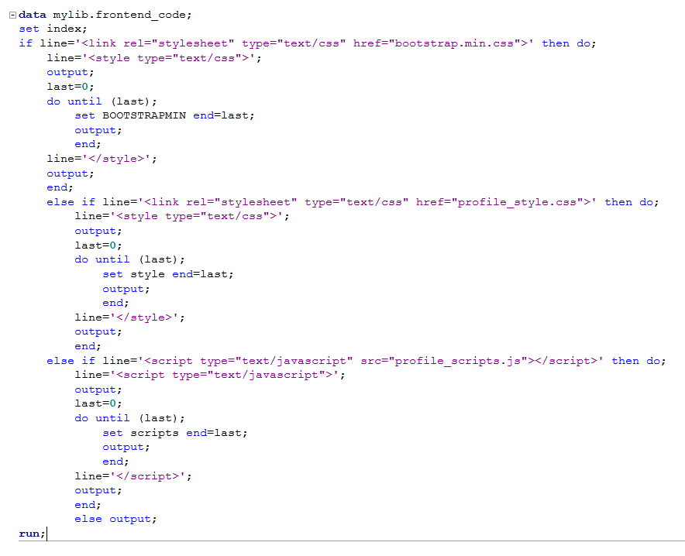
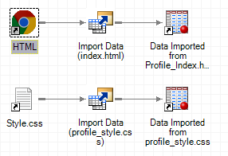
Front End Code

Slide 38
Front End Stored Process Code
*ProcessBody;
data _null_;
set mylib.frontend_code;
length outline $800;
file _webout;
if index(line,'&_METAFOLDER')>=1
or index(line,'&_SRVNAME')>=1 then outline=resolve(line);
else outline=line;
put outline;
run;

Slide 39
How it Works
Customer uses web form
Calls Stored Process
Parameterized SAS Code
Gets the data
Generates PDF and Excel output
Email results to customer

Slide 40
Thank You
Mara Werner
Data Scientist – HHS/OIG/OCDO
Mara.Werner@oig.hhs.gov
202-744-8539

